Slide 1
Modern Control Theory
Model Predict Control - MPC – Lecture 8
Unconstrained Control move calculation

Slide 2
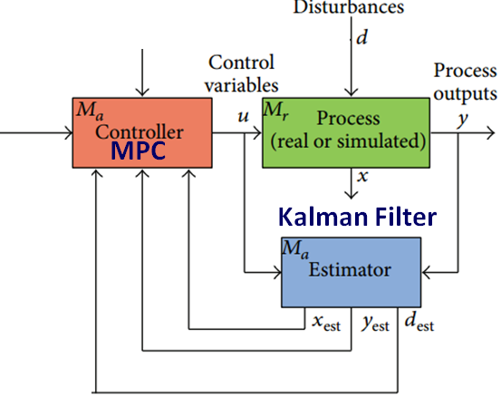
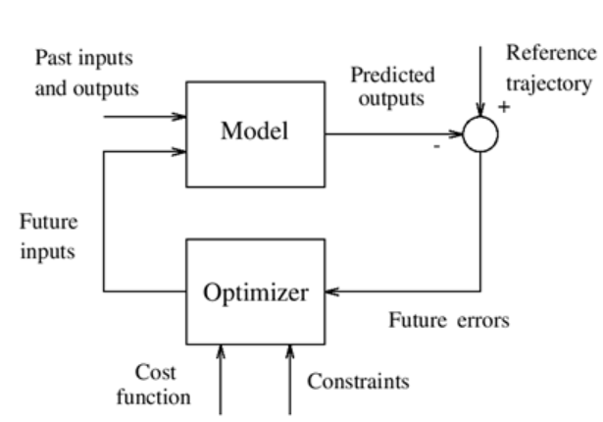

RECAP

Slide 3
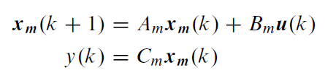

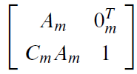
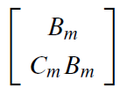

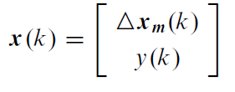
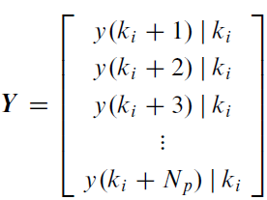
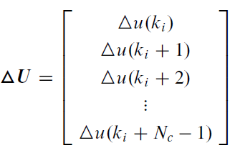
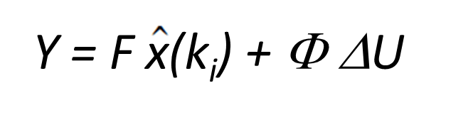
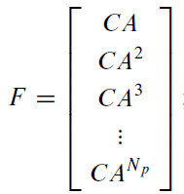
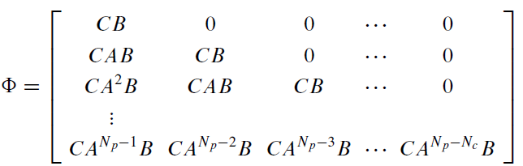
Prediction using State space models (6/6)
System
representation
System in incremental form
y(k+1) = C x(k+1)
A =
B =
C =
Output Prediction equation
Np x 1
Np x Nc

Slide 4
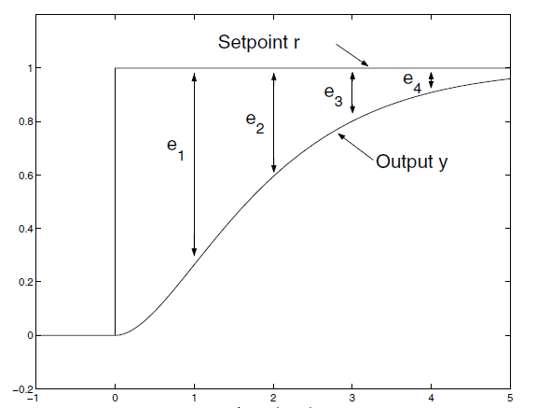
Cost function
Minimize the error between set-point and predicted response at all steps
This leads faster response
Minimize the control that minimized the error between set-point and predicted response at all steps
This leads trade off between faster response and use of input energy/
constraints on rate of change of input
For SISO system:
Y = Np step prediction for output (Np x 1)
Rs = Set-point trajectory into the future (Np x 1)
Δu = Nc future control moves (Nc x 1)
R is scalar – penalty on control move

Slide 5


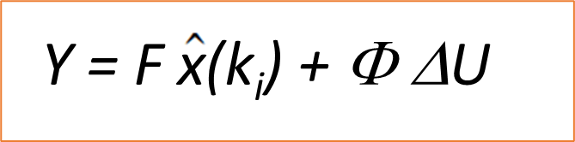
Unconstrained solution – SISO (1/2)
Objective function
(1)
The ΔU that minimized J can be obtained from the solution of
Substitute
In (1)
J = (R_{s} – F$\hat{x}$(k_{i}) – ΦΔU)^{T}(R_{s} – F$\hat{x}$(k_{i}) – ΦΔU) + ΔU^{T}RΔU
J = (R_{s} – F$\hat{x}$(k_{i}))^{T} (R_{s} – F$\hat{x}$(k_{i})) – (R_{s} – F$\hat{x}$(k_{i}))^{T}ΦΔU - (ΦΔU)^{T}(R_{s} – F$\hat{x}$(k_{i})) + ΔU^{T}Φ^{T}ΦΔU + ΔU^{T}RΔU
^
^
^

Slide 6



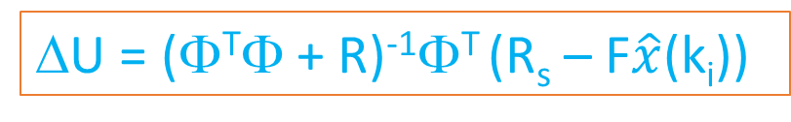
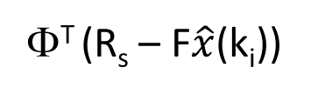
Unconstrained solution – SISO (2/2)
Now
=
^
+
= 0
(Φ^{T}Φ+ R)ΔU =
Φ^{T} (R_{s} – F$\hat{x}$(k_{i}))
Solving for ΔU we get
Implementation steps ONLINE
Obtain the current measurements of states,
Estimate the states using Kalman filter
Compute the optimal finite horizon control sequence (u_{k}, u_{k+1}, …u_{M})
Implement first move u_{k}
Repeat from Step 1
ΔU = (Φ^{T}Φ + R)⁻¹Φ^{T} (R_{s} – F$\hat{x}$(k_{i}))
u_{ki} = u _{(ki-1)} + Δu_{ki}
(first value in ΔU)
^

Slide 7
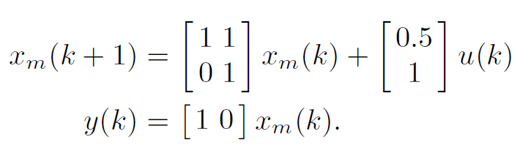
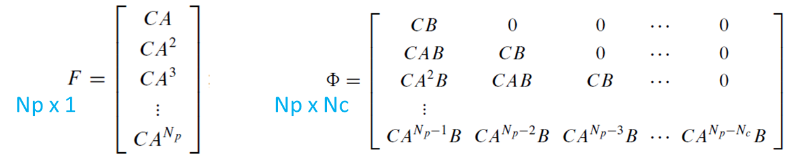


Example problem
Double integrator system
Matrices to compute:
Φ, F,
Φ^{T}Φ,
Φ^{T} R_{s}
Φ^{T} F
ΔU = (Φ^{T}Φ + R)⁻¹Φ^{T} (R_{s} – F$\hat{x}$(k_{i}))
A =
B =
C =
Np x 1
Np x Nc

